Slide 1

MATH30
Probability and Statistics

Slide 2
Simple Linear Regression Model
Regression analysis is one of the most important and widely used statistical techniques and has many applications in business and economics. A firm may be interested in estimating the relationship between advertising and sales (one of the most important topics of research in the field of marketing). Over a short range of values−when advertising is not yet overdone, giving diminishing returns−the relationship between advertising and sales may be well approximated by a straight line. The X variable in Figure 10-1 could denote advertising expenditure, and the Y variable could stand for the resulting sales for the same period. The data points in this case would be pairs of observations of the form x₁=$75,570, y₁=134,679 units; x₂=$83,090, y₂=151,664 units; etc. That is, the first month the firm spent $75,570 on advertising, and sales for the month were 134,679 units; the second month the company spent $83,090 on advertising, with resulting sales of 151,664 units for that month; and so on for the entire set of available data.

Slide 3
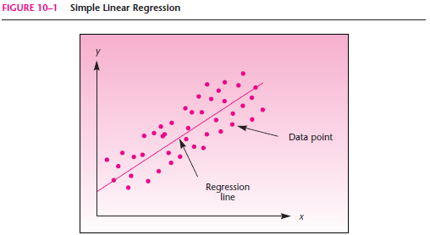
Simple Linear Regression Model

Slide 4
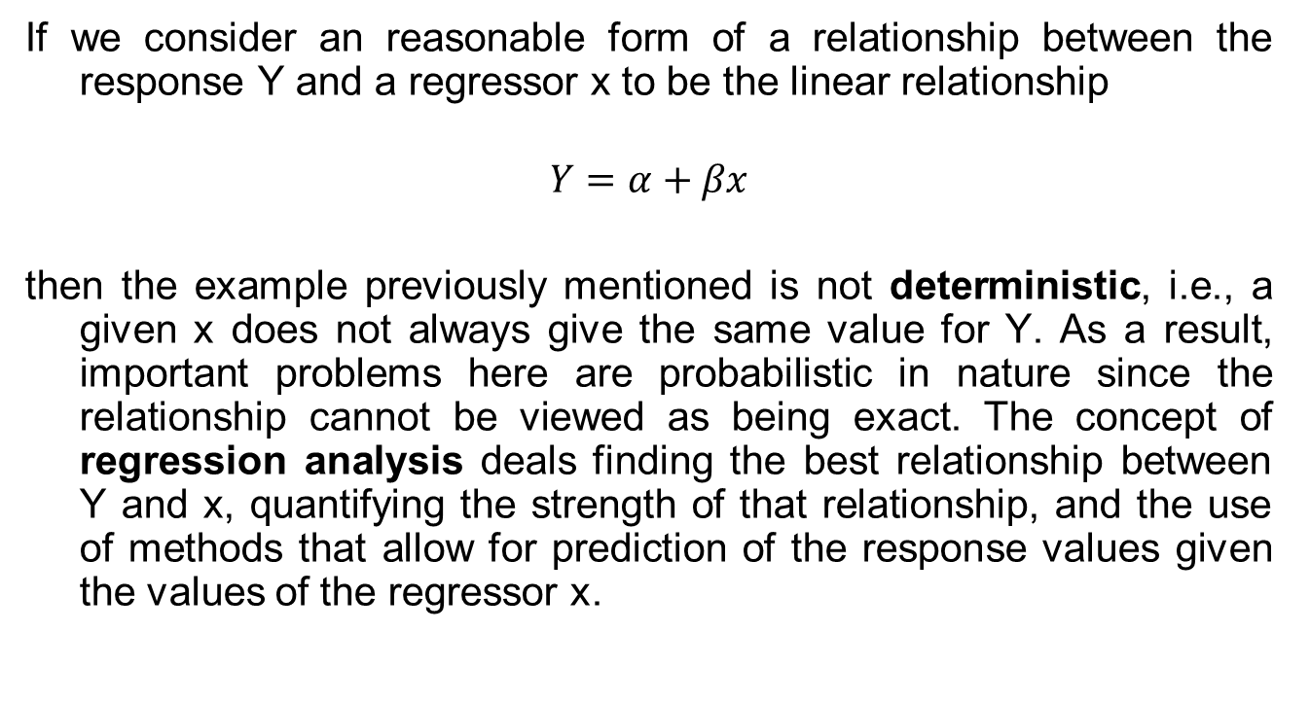
Simple Linear Regression Model
If we consider an reasonable form of a relationship between the response Y and a regressor x to be the linear relationship
$$Y=α+βx$$
then the example previously mentioned is not deterministic, i.e., a given x does not always give the same value for Y. As a result, important problems here are probabilistic in nature since the relationship cannot be viewed as being exact. The concept of regression analysis deals finding the best relationship between Y and x, quantifying the strength of that relationship, and the use of methods that allow for prediction of the response values given the values of the regressor x.

Slide 5
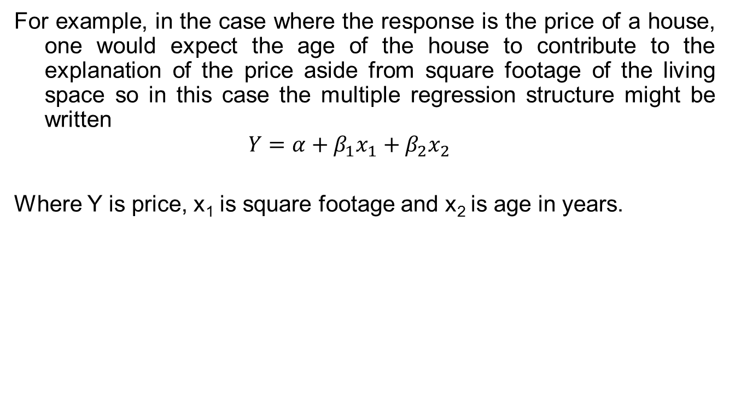
Multiple Regression
For example, in the case where the response is the price of a house, one would expect the age of the house to contribute to the explanation of the price aside from square footage of the living space so in this case the multiple regression structure might be written
$$Y=α+β_{1}x_{1}+β_{2}x_{2}$$
Where Y is price, x₁ is square footage and x₂ is age in years.

Slide 6
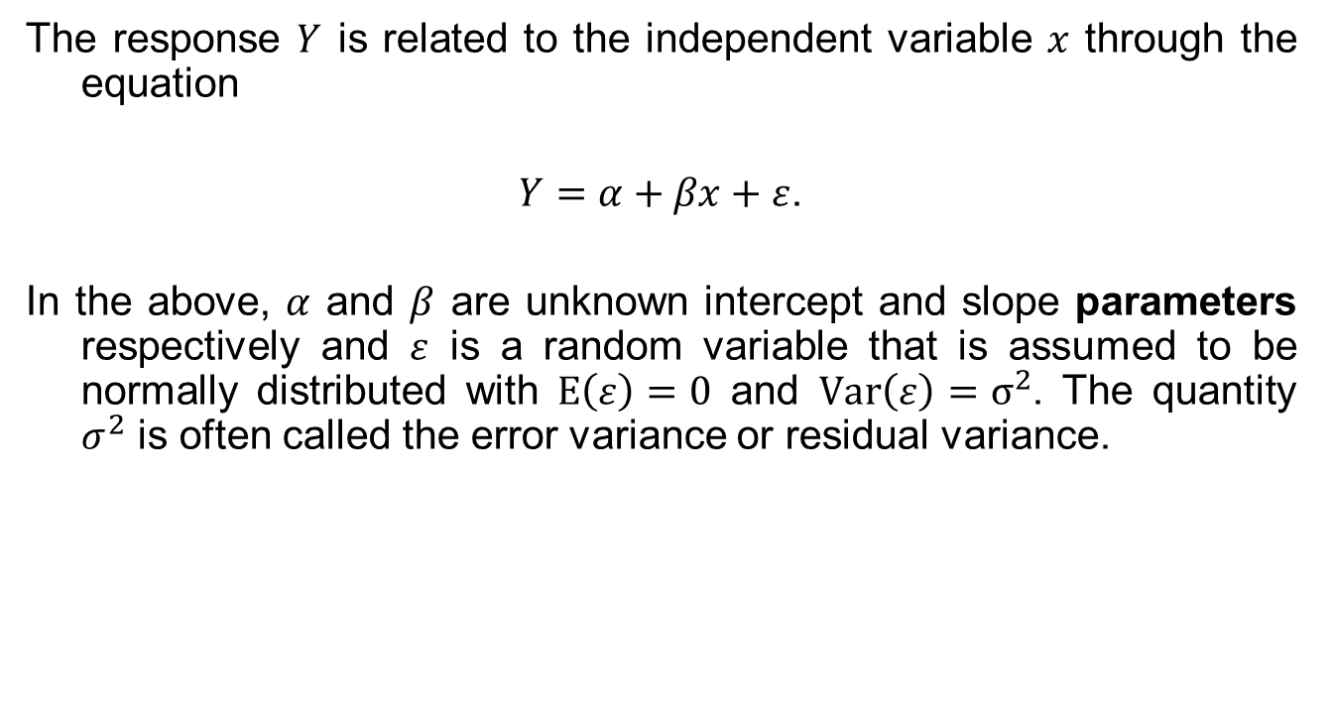
Simple Linear Regression Model
The response $Y$ is related to the independent variable $x$ through the equation
$Y=α+βx+ε$.
In the above, $α$ and $β$ are unknown intercept and slope parameters respectively and $ε$ is a random variable that is assumed to be normally distributed with $E\left(ε\right)=0$ and $Var\left(ε\right)=σ^{2}$. The quantity $σ^{2}$ is often called the error variance or residual variance.

Slide 7
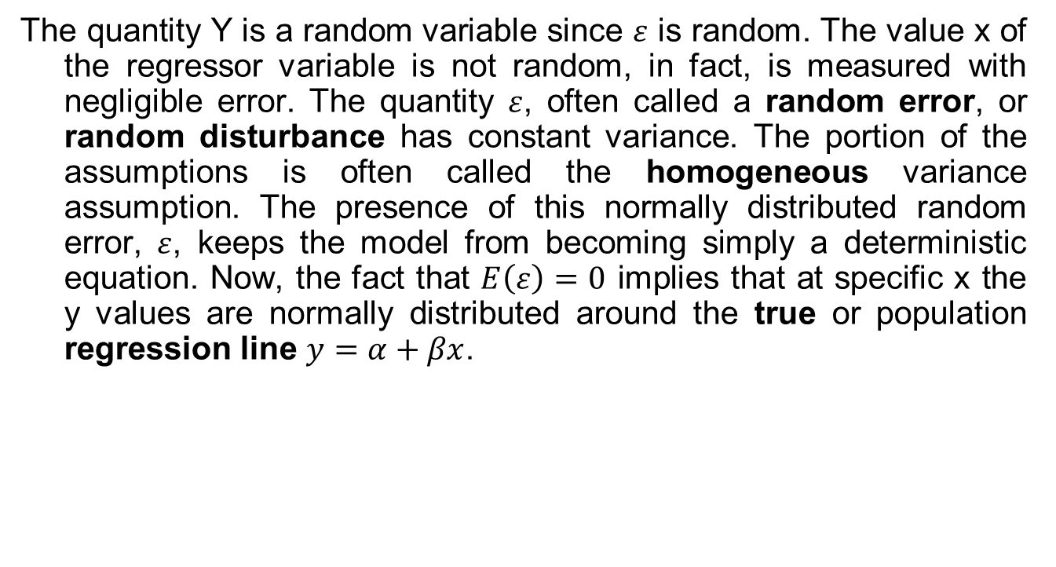
Simple Linear Regression Model
The quantity Y is a random variable since $ε$ is random. The value x of the regressor variable is not random, in fact, is measured with negligible error. The quantity $ε$, often called a random error, or random disturbance has constant variance. The portion of the assumptions is often called the homogeneous variance assumption. The presence of this normally distributed random error, $ε$, keeps the model from becoming simply a deterministic equation. Now, the fact that $E\left(ε\right)=0$ implies that at specific x the y values are normally distributed around the true or population regression line $y=α+βx$.

Slide 8
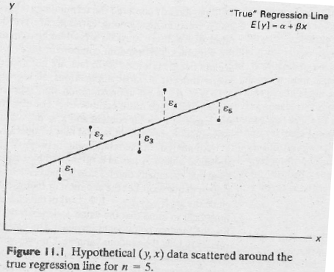

Simple Linear Regression Model
The model described is conceptual in nature. As a result, one never observes the actual $ε$ values in practice and thus one can never draw an estimated line. Figure 11.1 depicts the nature of hypothetical (y, x) data scattered around a true regression line for a case in which only n=5 observations are available.

Slide 9
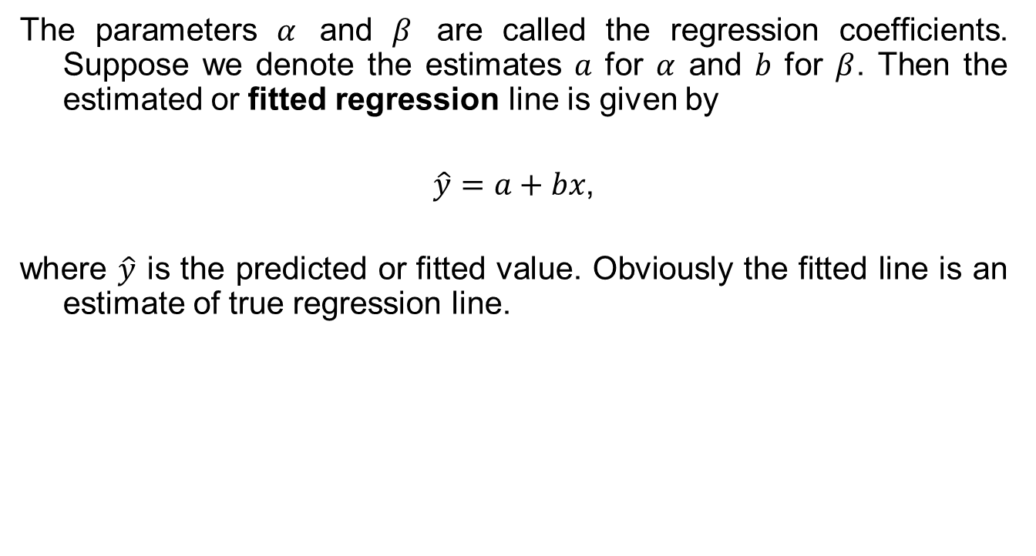
The Fitted Regression Line
The parameters $α$ and $β$ are called the regression coefficients. Suppose we denote the estimates $a$ for $α$ and $b$ for $β$. Then the estimated or fitted regression line is given by
$\hat{y}=a+bx$,
where $\hat{y}$ is the predicted or fitted value. Obviously the fitted line is an estimate of true regression line.

Slide 10
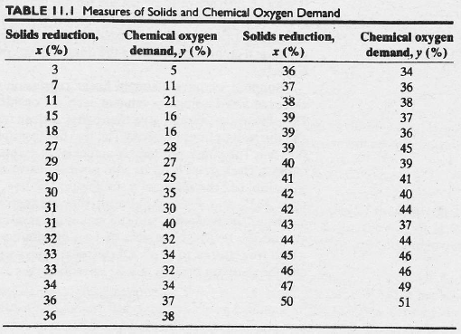
Simple Linear Regression Model

Slide 11
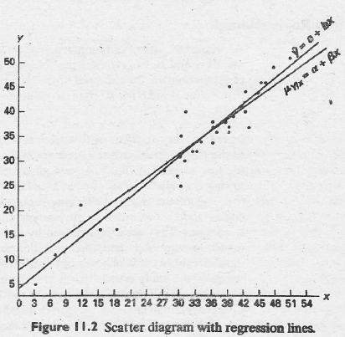
Simple Linear Regression Model
The fitted regression line and a hypothetical true regression line are shown on the scatter diagram of Figure 11.2.

Slide 12

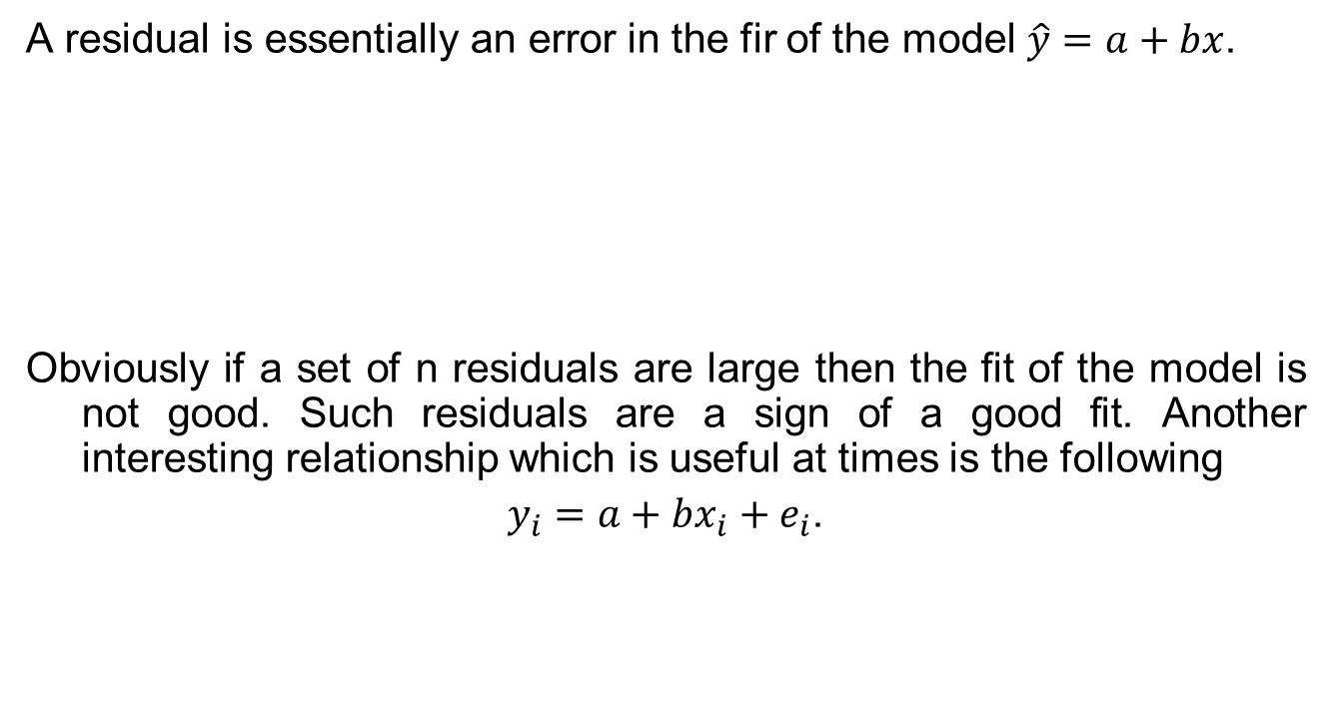
Least Squares and the Fitted Model
A residual is essentially an error in the fir of the model $\hat{y}=a+bx$.
Obviously if a set of n residuals are large then the fit of the model is not good. Such residuals are a sign of a good fit. Another interesting relationship which is useful at times is the following
$y_{i}=a+bx_{i}+e_{i}$.

Slide 13

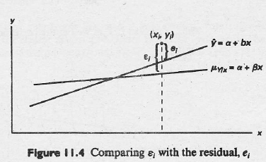
Least Squares and the Fitted Model

Slide 14
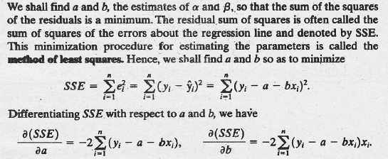
The Method of Least Squares

Slide 15
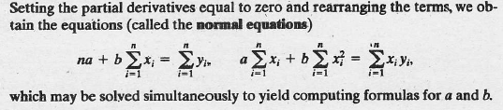
The Method of Least Squares

Slide 16
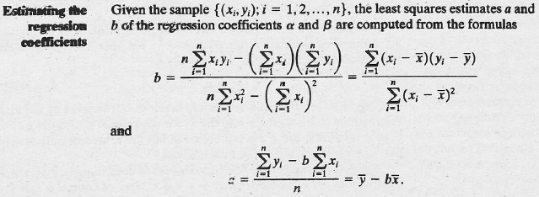
The Method of Least Squares

Slide 17
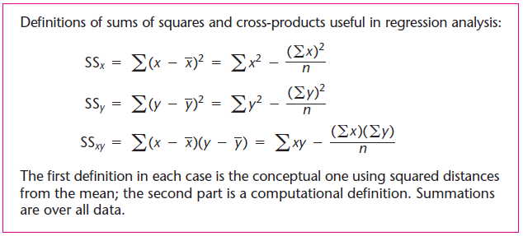

The Method of Least Squares
Least squares regression estimators include the slope
$$b=\frac{{SS}_{xy}}{{SS}_{x}}$$
and the intercept $a=\overline{y}−b\overline{x}$.

Slide 18
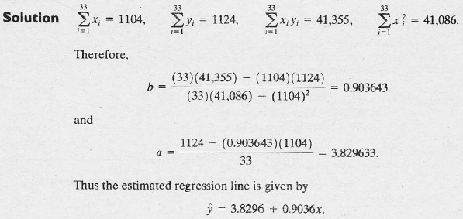
The Method of Least Squares
Example 11.1 Estimate the regression line for the pollution data of Table 11.1.

Slide 19
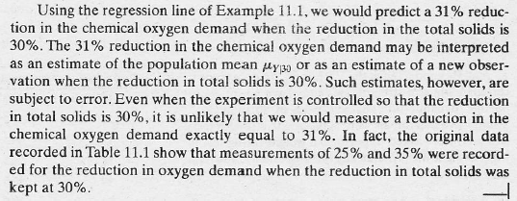
The Method of Least Squares

Slide 20
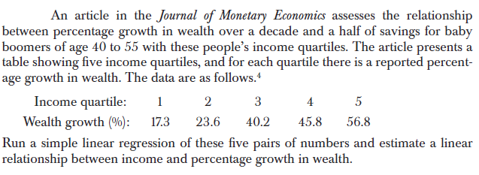
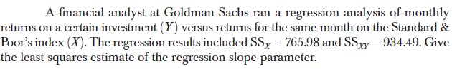
The Method of Least Squares

